Slide 1



AASM Callback & Sidekiq
By Wan Zulkarnain
https://github.com/wzul

Slide 2
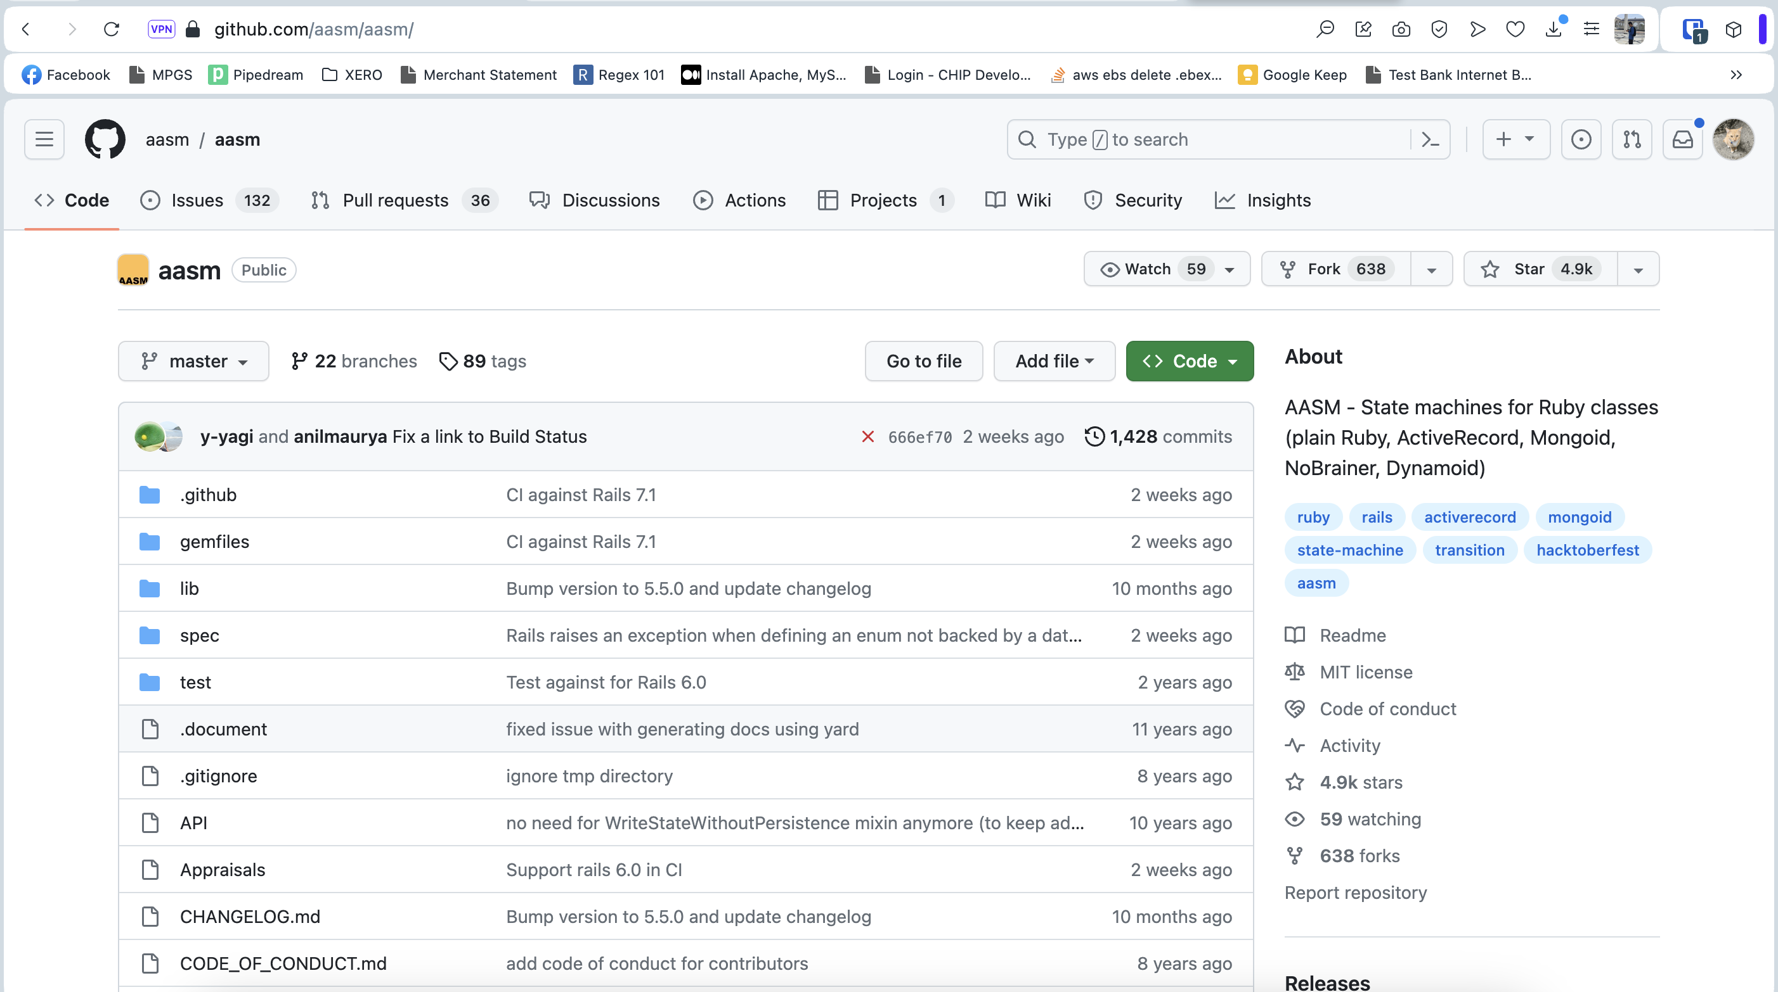
AASM
Short form for “act_as_state_machine”.
Useful for manipulating state for a specific record.
https://github.com/aasm/aasm/

Slide 3

Sidekiq
Framework to run a task independently from main thread.
Ultra-fast compared to delayed job (introduced by Shopify)
https://github.com/sidekiq/sidekiq

Slide 4
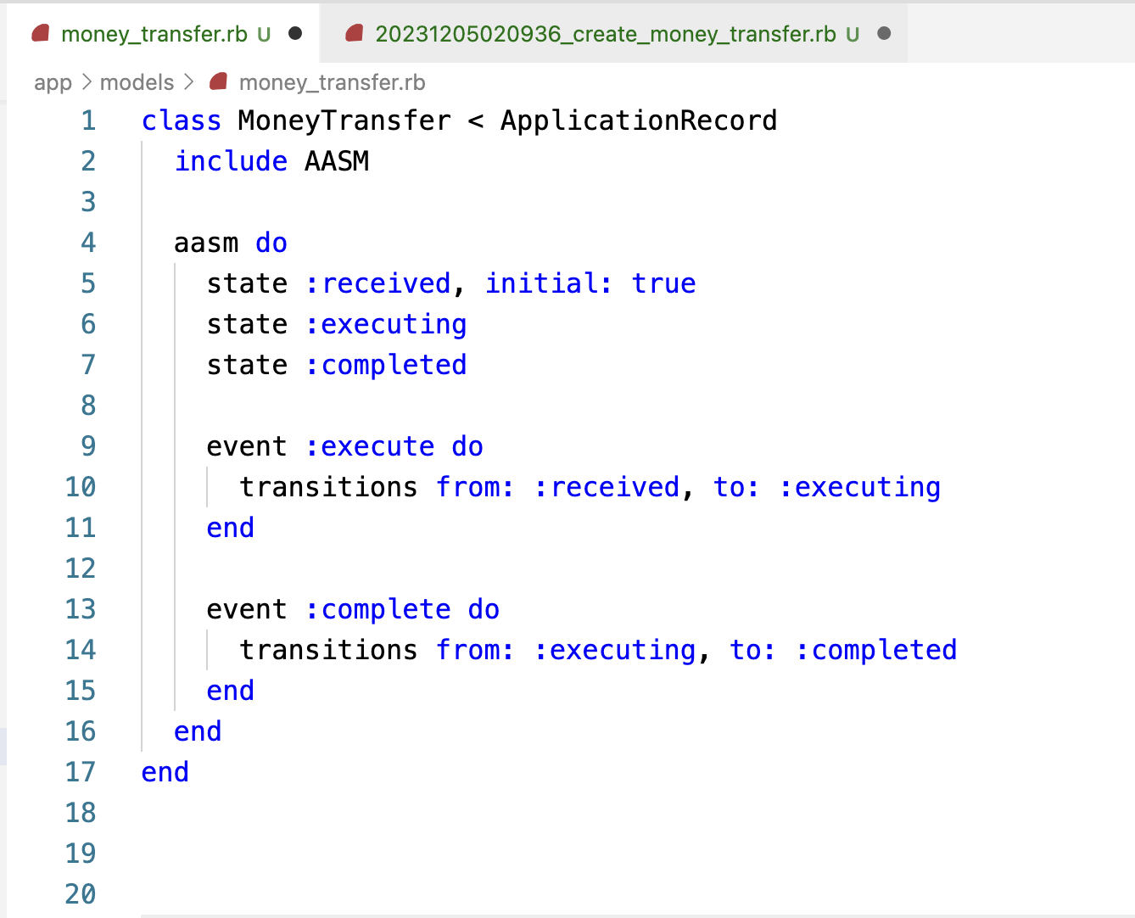
Example: Money Transfer
3 states:
Received
Executing
Completed
2 events:
Execute
Complete

Slide 5
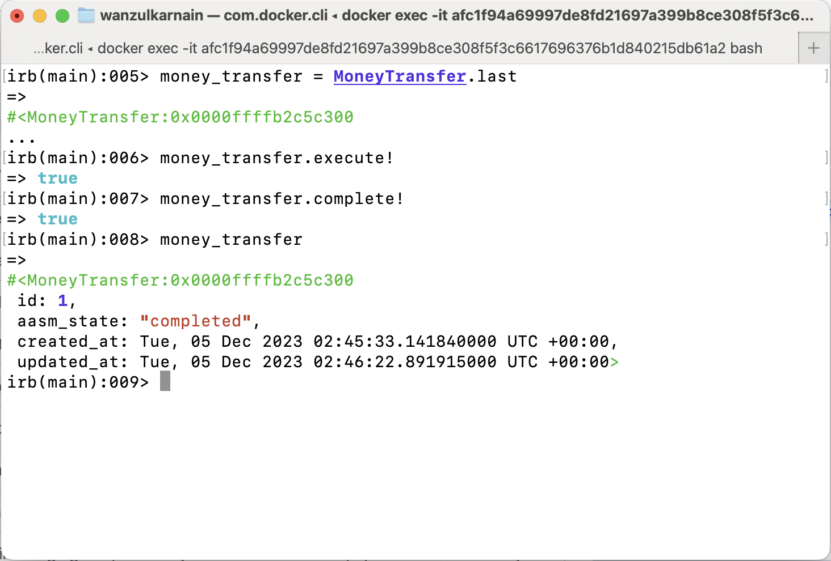
AASM facilitate state changes
irb(main):012> money_transfer.aasm_state
=> "received"
irb(main):013> money_transfer.execute!
=> true
irb(main):014> money_transfer.aasm_state
=> "executing"
irb(main):015> money_transfer.complete!
=> true
irb(main):016> money_transfer.aasm_state
=> "completed"

Slide 6
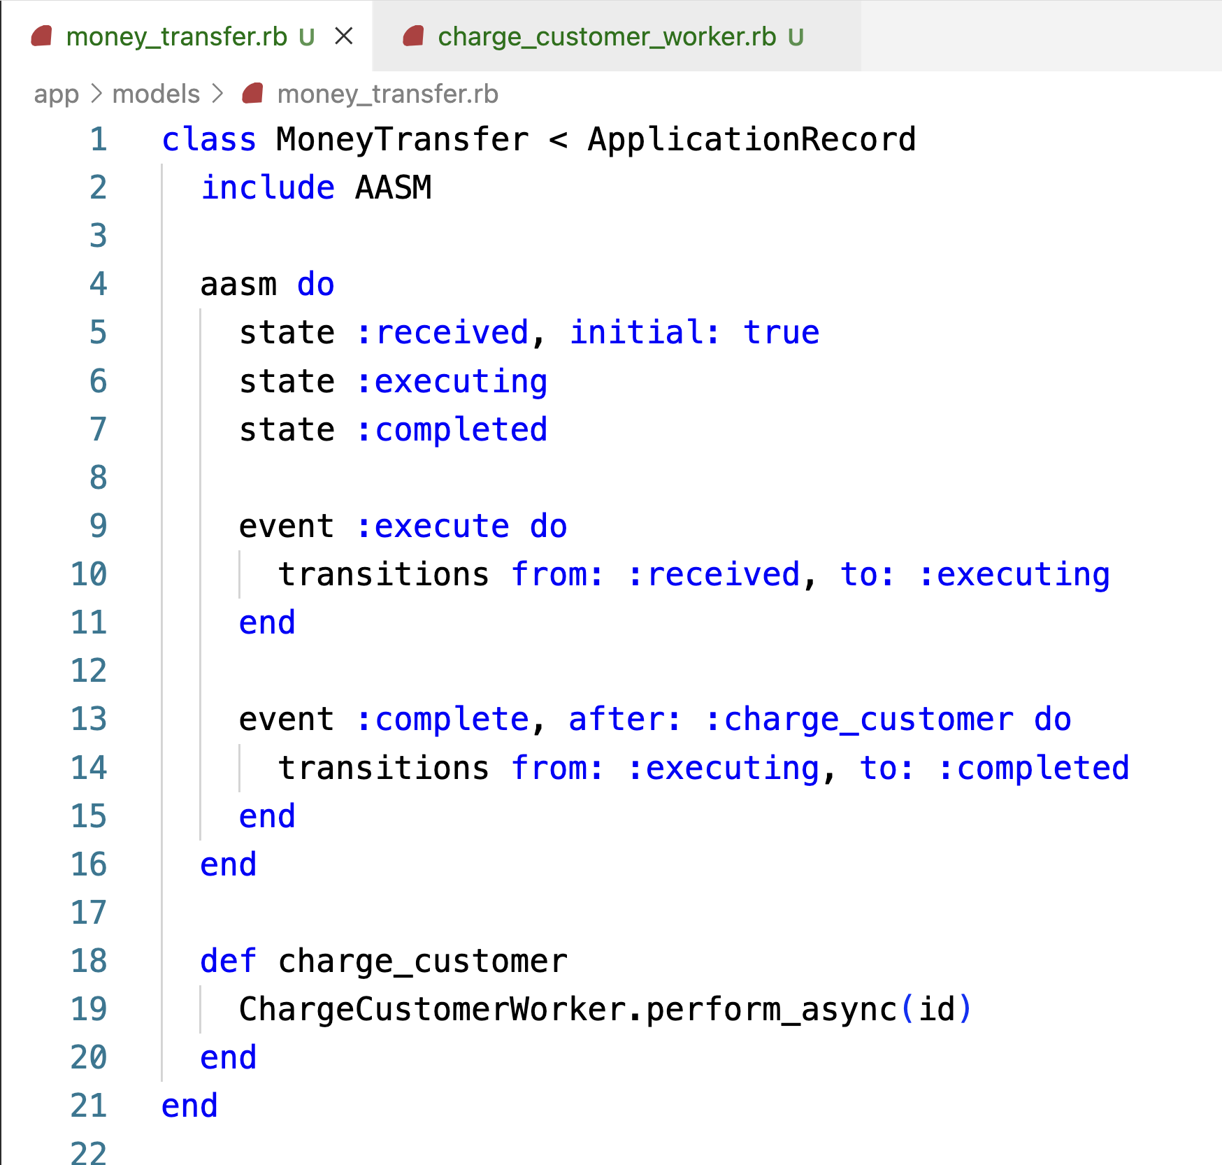
Let’s add callback
Hook :complete event with :charge_customer
event :complete, after: :charge_customer do
Method charge_customer
ChargeCustomerWorker.perform_async id

Slide 7

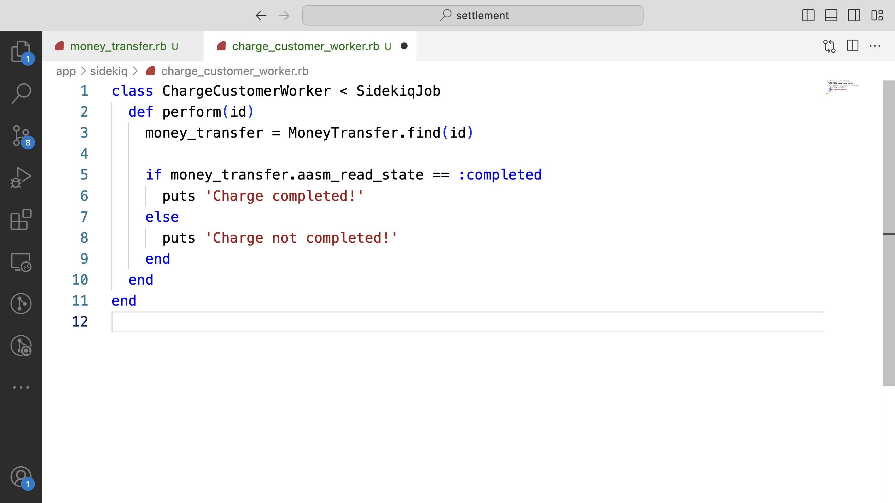
And define the worker

Slide 8
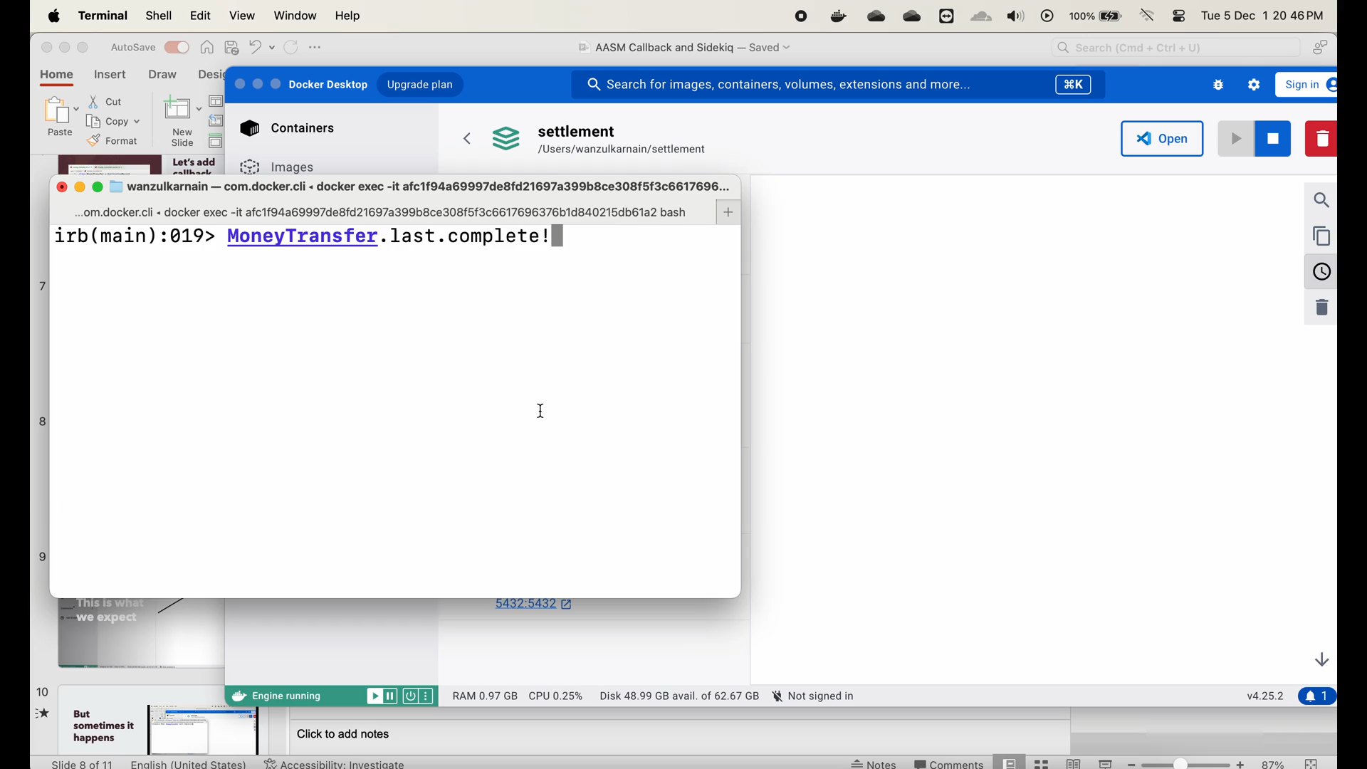
This is what we expect

Slide 9
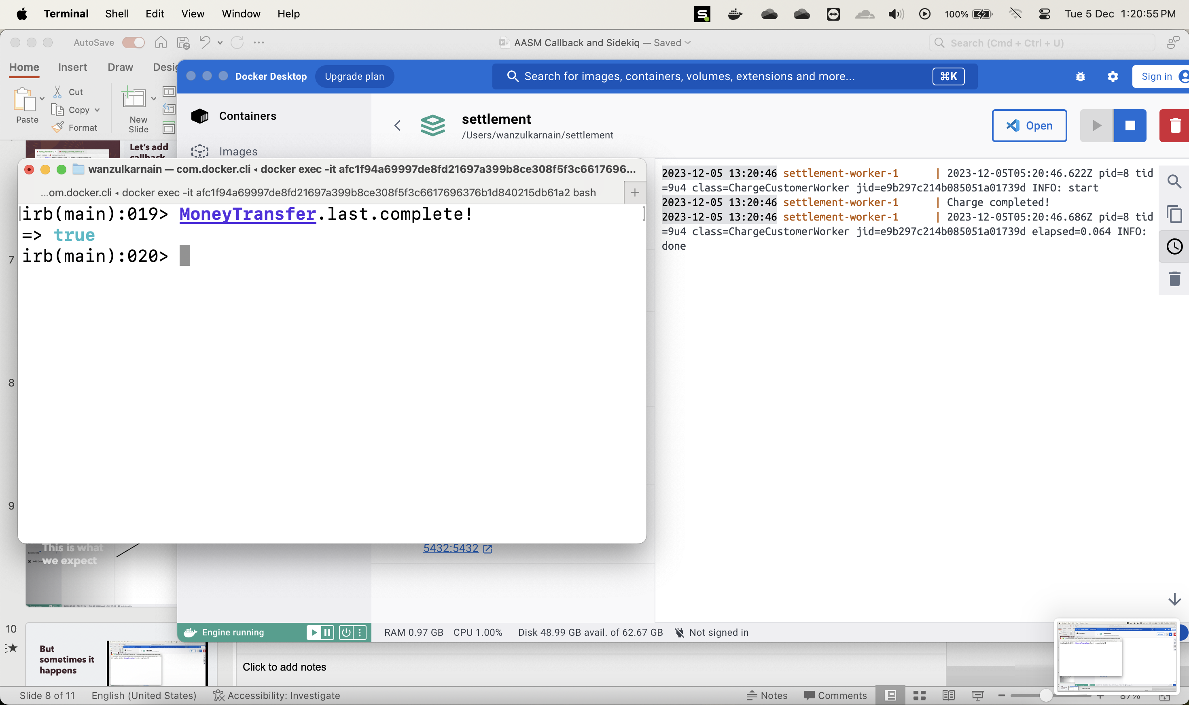
This is what we expect

Slide 10
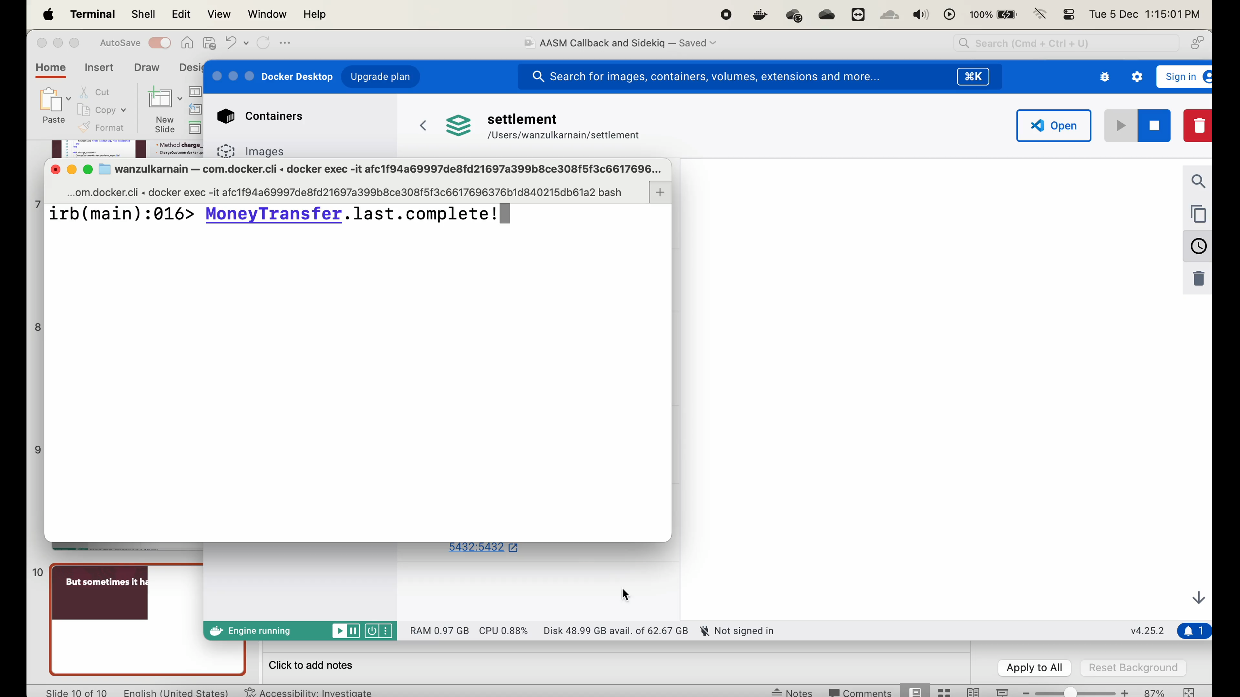
But sometimes it happens

Slide 11
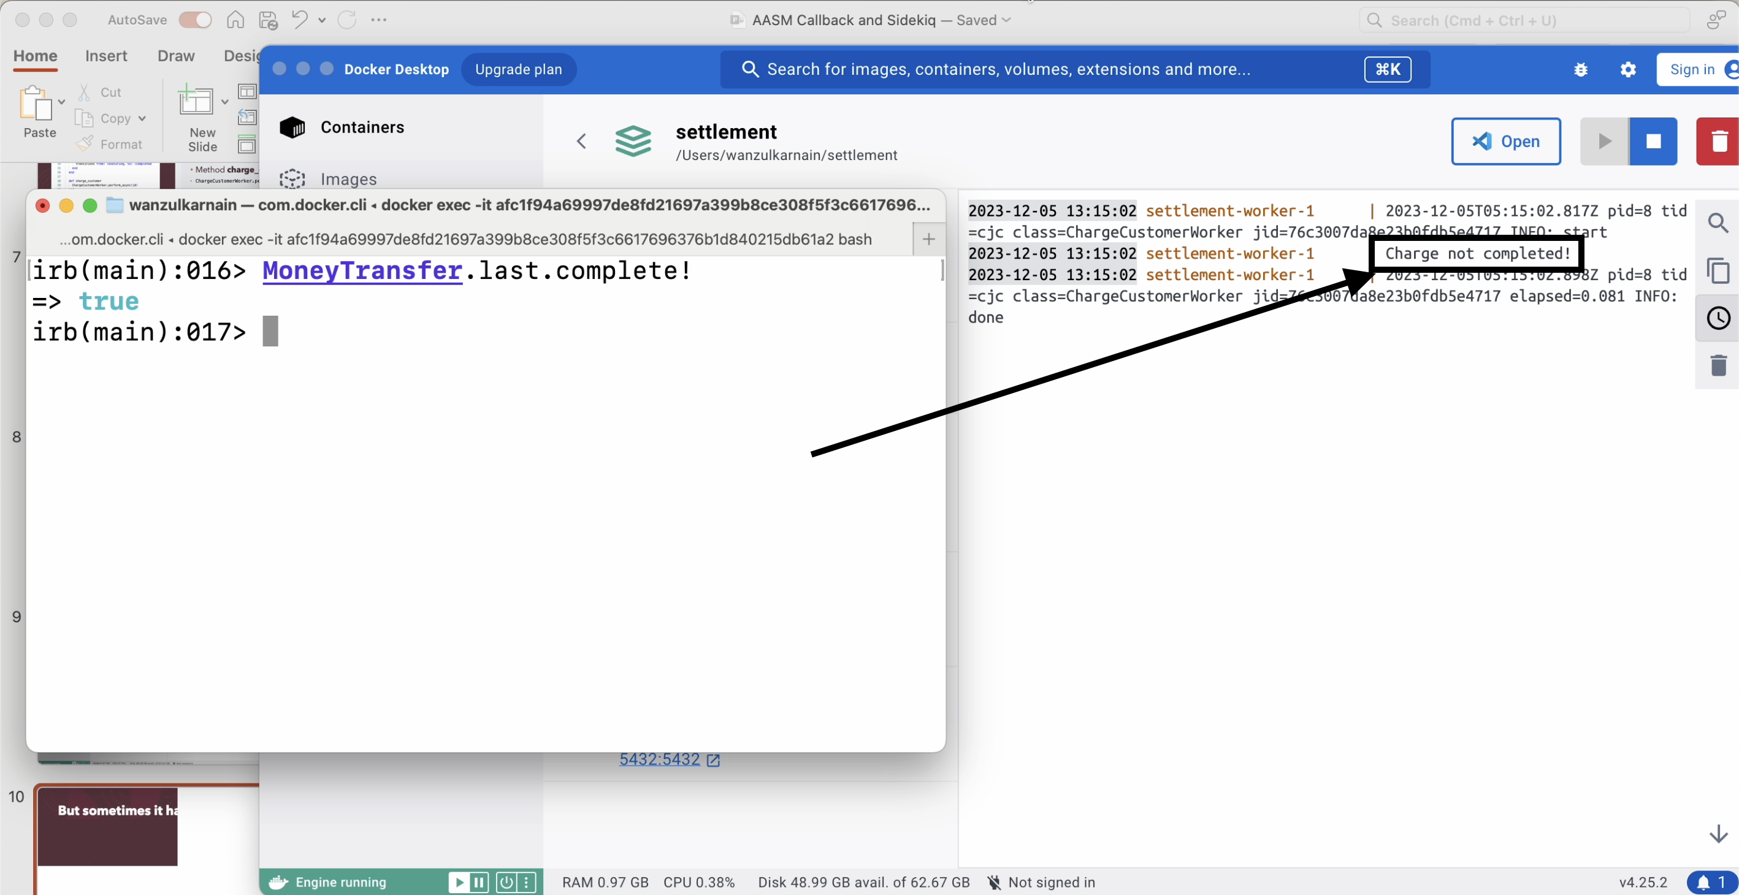
But sometimes it happens

Slide 12
Cause?
AASM after callback is executed before database commit.
Sidekiq execute the job earlier than database commit.
Usually, it doesn’t happen in local development, but happened in production.

Slide 13


How to replicate?
Add before_commit block and delay for X seconds.
before_commit :delay
def delay
sleep(2)
end

Slide 14
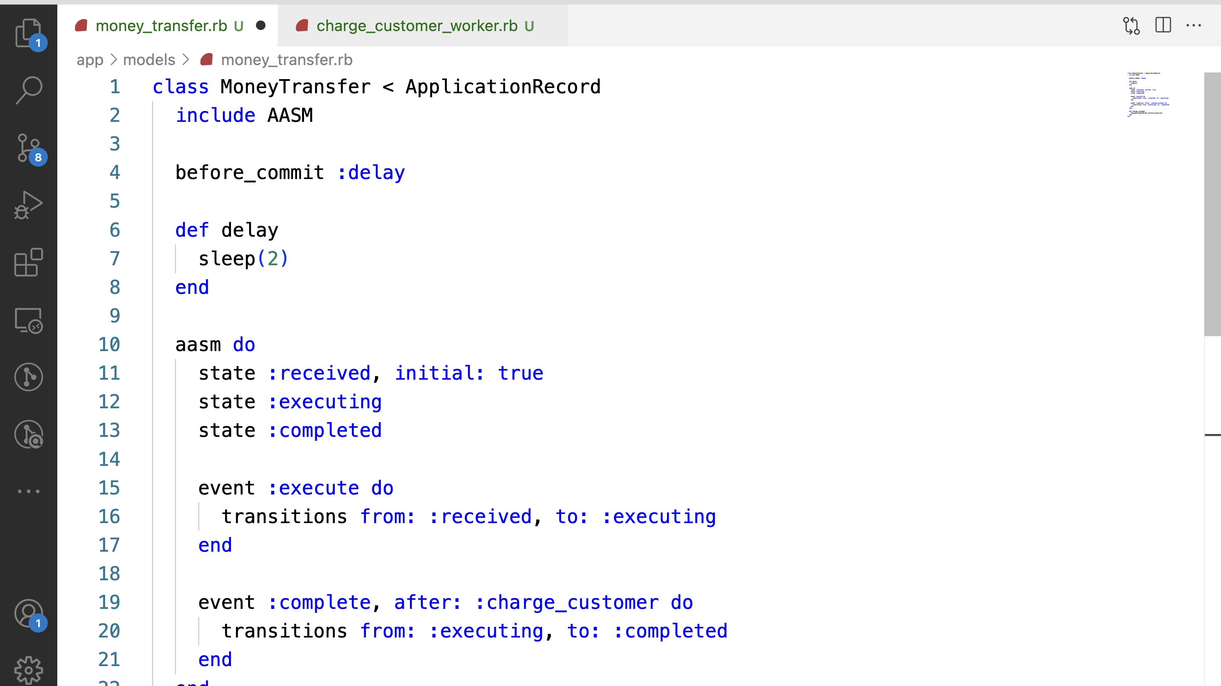
How to replicate?

Slide 15
How to prevent?
Use callback after_commit instead of after.
Don’t attempt to add delay to the job!

Slide 16
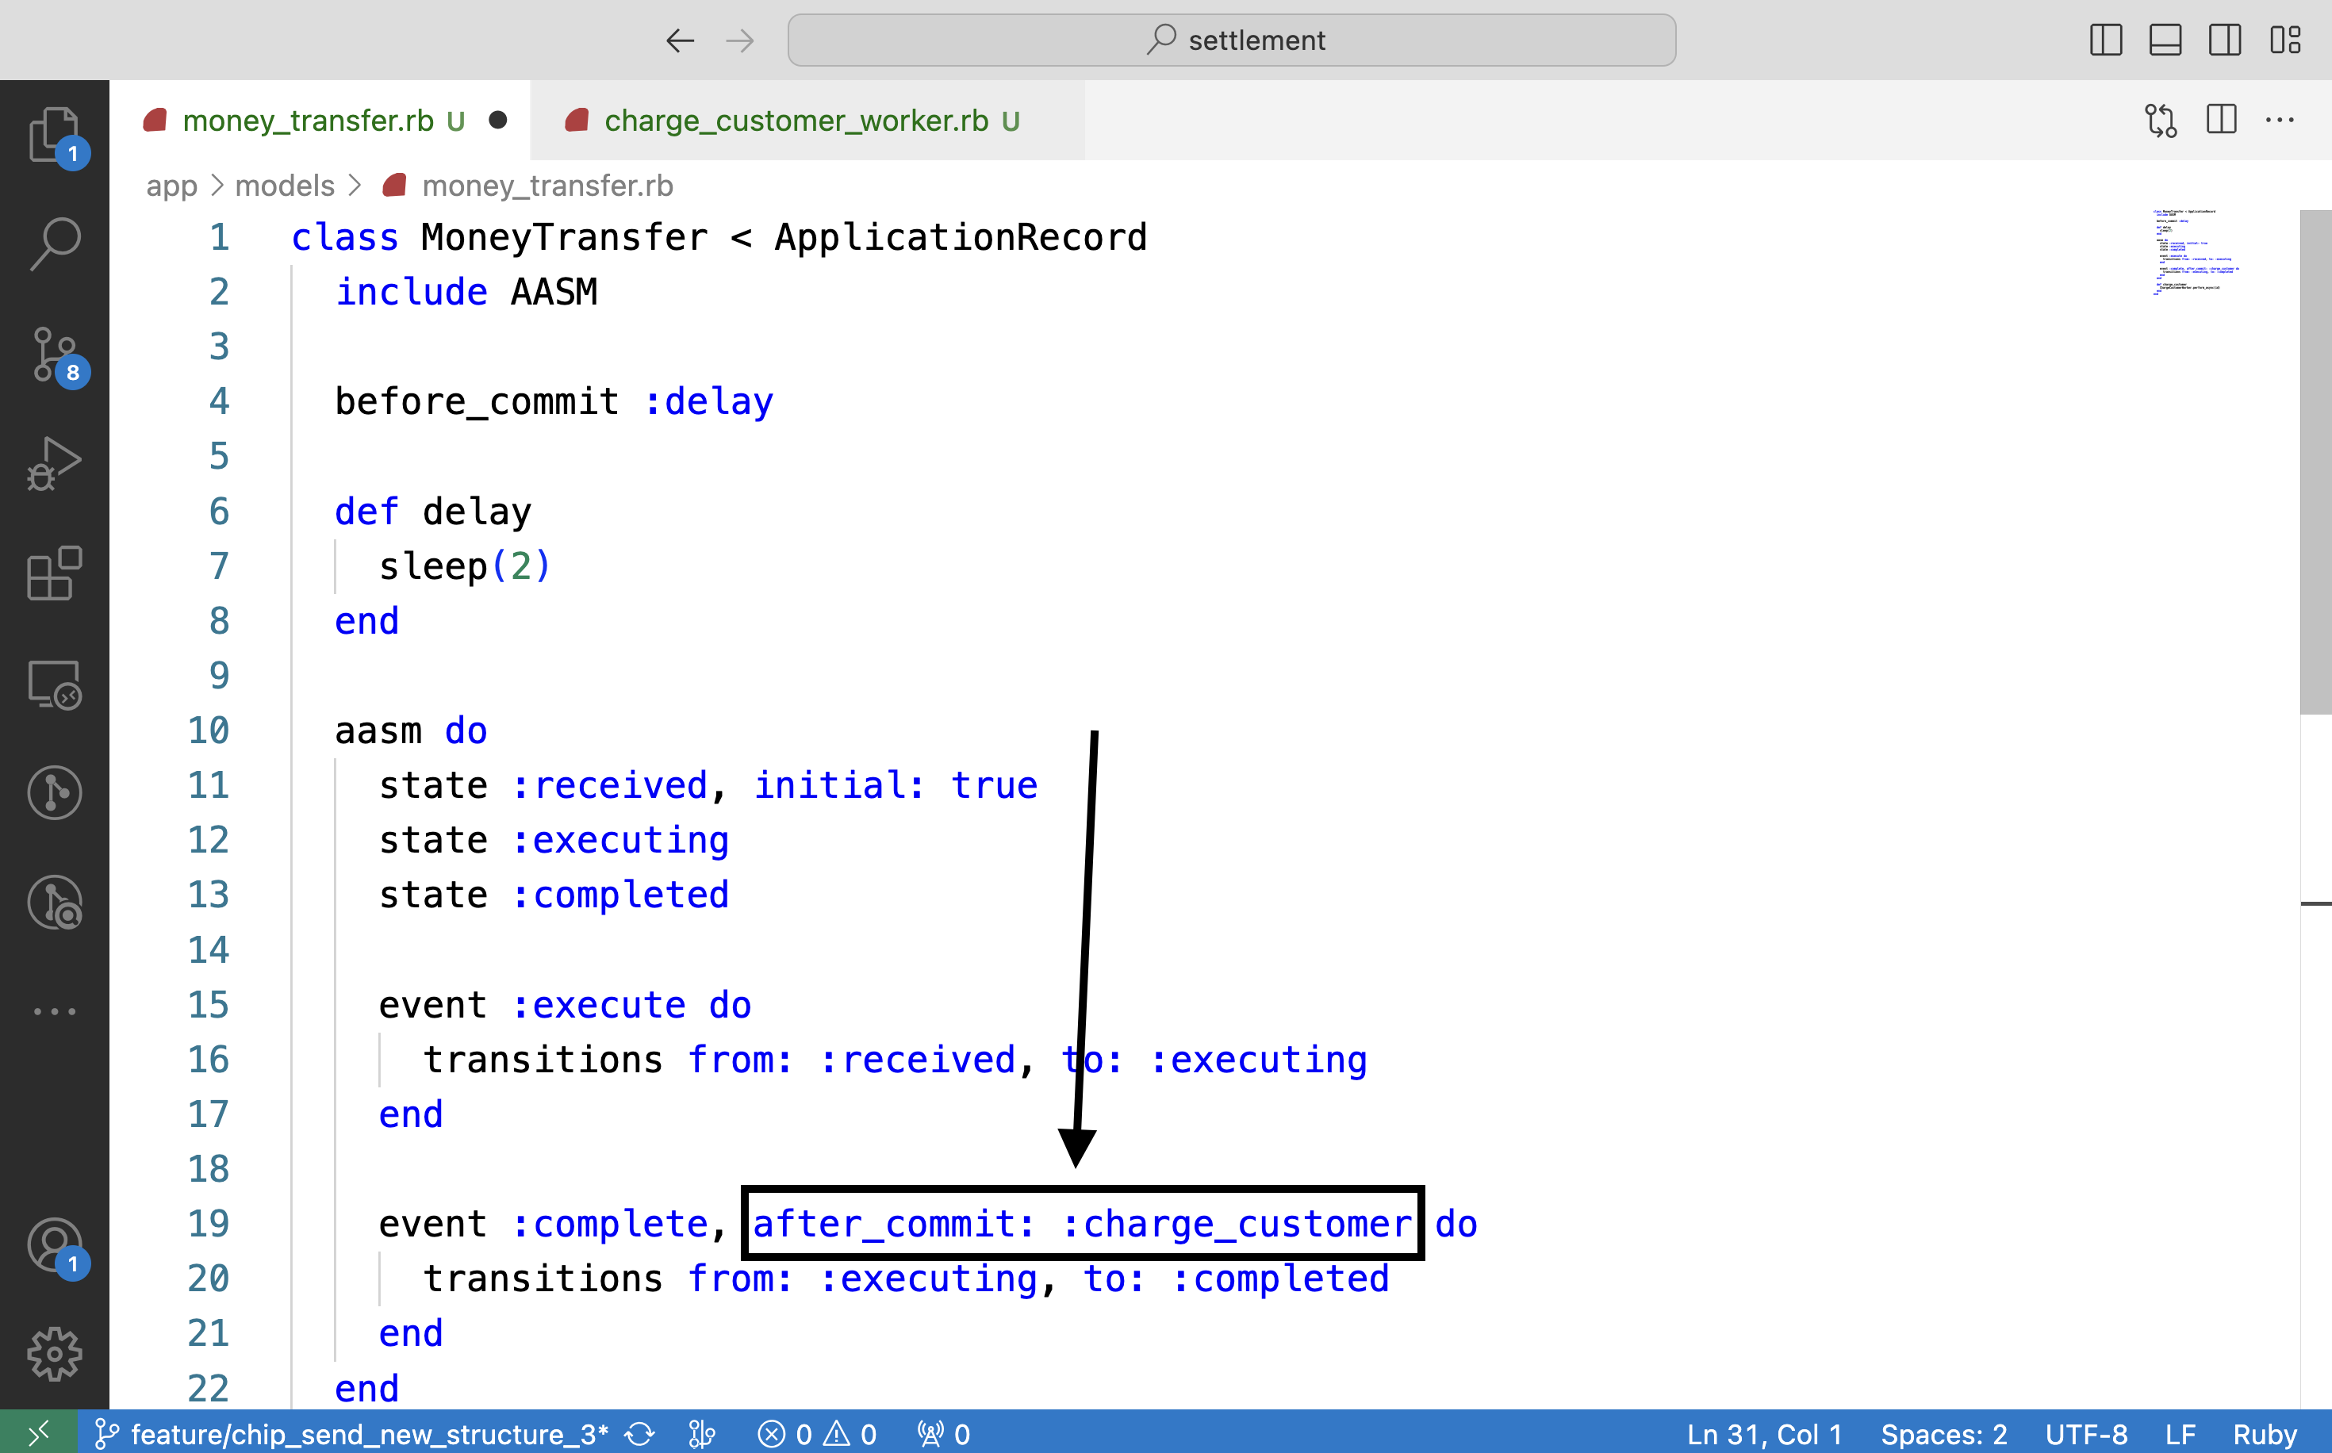
Do

Slide 17
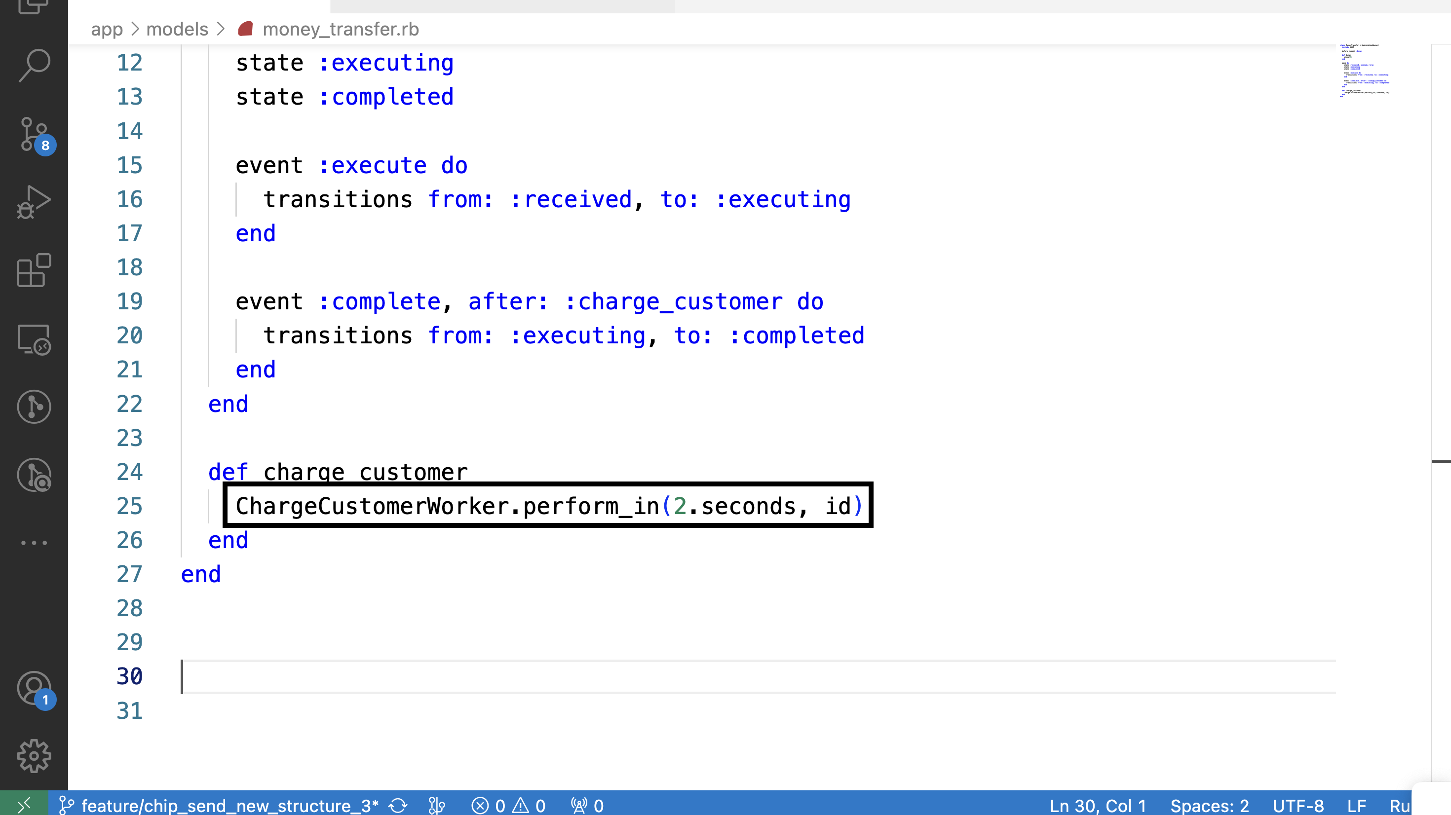
Don’t

Slide 18

Thanks!

